Slide 1
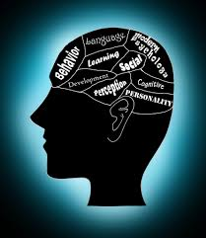

Human Behavior Management
Course Instructor: Dr. Nandini Banerjee

Slide 2
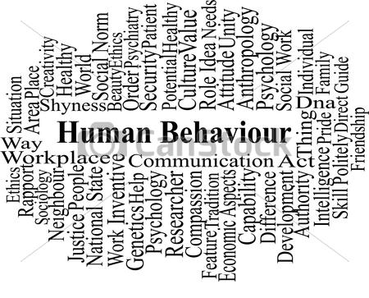

Understanding Human Behavior

Slide 3
Course Title: Human Behavior Management
Course Code: HM 333
Target Audience: Students of 7th Semester of B.Tech program and MSC IT data sc.
Course Structure: 3 – 0 – 0 – 3
Course Contents:
1. Life skill Development : SWOT analysis, Goal setting, Self esteem and self confidence, Emotional Intelligence.
2. Psychology of Human Behavior, Freudian Theory, States of consciousness, Personality Traits, Social Psychology
3. Cognitive Psychology , Leadership, Self Awareness and Self Discovery.
4. Developing Communication skills, Transactional Analysis, Public speaking, Presentation skills.
5. Behavioral psychology, Group Dynamics, Attitude, Problem Solving and Decision making.

Slide 4
Grading Policy:
The course will have activities, case studies, and regular examinations.
Hence it would have the following evaluation components with their corresponding weightages
S. No. | Evaluation Component | Weightage
1. | In-semester Examinations 1 and 2 | 40 %
2. | Classroom Activities ,Role plays, Case Studies, Discussions/GD, Assignments and Presentations ( need to interact in class), class attendance. | 15 %
3. | End-semester Examination | 30 %
4. | Overall Impression (Participation in Course) | 5 %
5. | Project | 10 %

Slide 5
Teaching Methodology
Lectures
Case studies
Interactive studies/ Discussions
Article Reviews and Book Reading
Role plays
Games and Activities
Presentations

Slide 6
Books:
1. Gary Dessler, Human Resource Management, 13th Edition, Pearson Education, 2015.
2. Courtland L Bovee, John V. Thill, and Barbara E. Schatzma, Business Communication Today, 7th Edition, Pearson, 2003.
Stacey Magner, Modern Business Etiquette for Young and Fabulous Professionals, Spencer Crane, 2018.
4. Eric Berne, Games People Play, New York, Penguin Group, 2010
5. Thomas A. Harris, I’m OK – You’re OK, New York, Harper, 1967

Slide 7
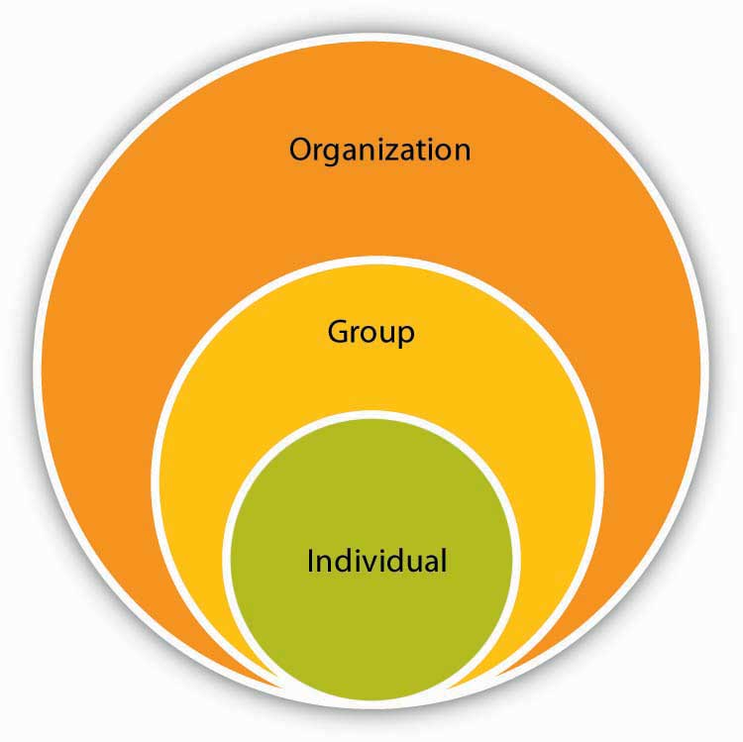
I/O Psychology
It is related to individuals, group of people working together in teams.

Slide 8
Behavioural
Contribution
Unit of
Output
science
analysis
Learning
Motivation
Perception
Training
Leadership effectiveness
Job satisfaction
Psychology
Individual decision making
Performance appraisal
Attitude measurement
Employee selection
Work design
Work stress
Individual
Group dynamics
Work teams
Communication
Power
Conflict
Sociology
Intergroup behaviour
Formal organization theory
Study of
Organizational technology
Group
Organizational
Organizational change
Behaviour
Organizational culture
Behavioural change
Social psychology
Attitude change
Communication
Group processes
Group decision making
Organization
Comparative values
system
Comparative attitudes
Anthropology
Cross-cultural analysis
Organizational culture
Organizational environment
Political science
Conflict
Intraorganizational politics
Power

Slide 9
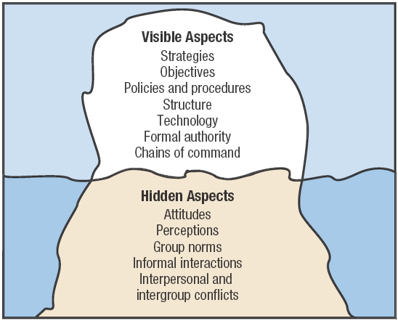

Slide 10
Behavioral psychology, or behaviorism, is a theory suggesting that environment shapes human behavior. In a most basic sense, behavioral psychology is the study and analysis of observable behavior.
Human behavior refers to the way humans act and interact. It is based on and influenced by several factors, such as genetic make-up, culture and individual values and attitudes.
Behavior is how someone acts. It is what a person does to make something happen, to make something change or to keep things the same. Behavior is a response to things that are happening:
internally - thoughts and feelings.
externally - the environment, including other people.
Behavior serves a purpose and has a reason, including:
communication - through use of body language, facial expressions, gestures and silence
function - to help meet a need, attract attention, gain an internal or sensory sensation, access an item or activity, or get away from something.
The key to understanding behavior is to understand why it is occurring, what is being communicated or what is needed.

Slide 11
Classifications of Human Behavior
1. Molecular and Moral Behavior
Molecular Behavior: It is an unexpected behavior that occurs without thinking. One example is suddenly closing eyes when something is about to this the eyes.
Moral Behavior: Unlike molecular behavior, this type of behavior occurs after thinking. For example, a person changes the way when she or he sees a harmful thing.
2. Overt & Covert Behavior
Overt Behavior: It is a visible type of behavior that can occur outside of human beings. Eating food, riding on a bicycle, and playing football are some examples.
Covert Behavior: Unlike overt behavior, this type of behavior is not visible. Thinking is a good example of covert behavior because no one can see us thinking.
3. Voluntary and Involuntary Behavior
Voluntary Behavior: It is a type of behavior that depends on human want. We can characterize walking, speaking, and writing as voluntary behaviors.
Involuntary Behavior: Unlike voluntary behavior, this type occurs naturally and without thinking. Breathing air is a perfect example of involuntary behavior.

Slide 12
Techniques from Behavioral Psychology
Systematic desensitization is used for clients who have a specific phobia, which is characterized by marked fear or anxiety about an object or situation, like an animal or airplanes. Therapy involves applying relaxation or coping techniques as people are gradually exposed to the object or situation.
Exposure and response prevention is a strategy that involves exposure to fearful situations, and then not engaging in unhelpful coping strategies. This therapeutic technique is used for obsessive-compulsive disorder (OCD) and other types of anxiety disorders.
Token economy reinforces target behavior by giving children and adults symbols or tokens that can be exchanged for something else. It can be used for people with a wide range of mental health issues, as well as in educational settings.
Modeling involves clients learning behavior by imitation alone. It’s used in developmental psychology and can be incorporated into clinical use.
Applied behavior analysis emerged in the 1960s as a way to modify behavior. It is commonly used for children with an autism spectrum disorder, and is also relevant to fields like education, industrial safety, and criminal behavior.
Contingency management involves individuals receiving vouchers for retail goods and services, or the opportunity to win prizes. Often used for patients with substance abuse or related disorders, it typically takes the form of monetary-based reinforces for drug-negative tests, according to The Psychiatrist.

Slide 13
Behavioral Psychology
The study of Psychology that focusses on learned behaviours. This school of Psychology was prominent in the early twentieth century, and still is used to explain how certain behaviours are learned and reinforced. Mental health professionals will use behavioural techniques such as cognitive bahvoural therapy to help clients in a variety of ways including but not limited to:
Anxiety disorders
Mood disorders
Insomnia
Severe mental disorders
Problems in children and adolescents

Slide 14
Behaviorism focuses on observable behavior as a means to studying the human psyche.
The main influences of behaviorist psychology were Ivan Pavlov (1849-1936), who investigated classical conditioning though often disagreeing with behaviorism or behaviorists
Ivan Pavlov, is known for his work on one important type of learning, classical conditioning. As we learn, we alter the way we perceive our environment, the way we interpret the incoming stimuli, and therefore the way we interact, or behave.

Slide 15
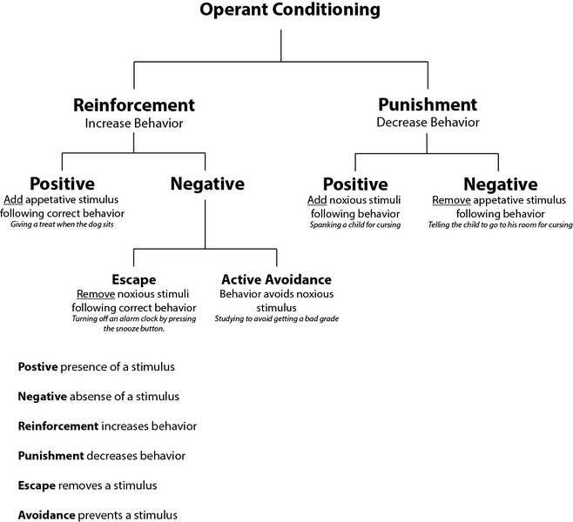

Slide 16
Reinforcement means to strengthen, and is used in psychology to refer to any stimulus which strengthens or increases the probability of a specific response. For example, if you want your dog to sit on command, you may give him a treat every time he sits for you. The dog will eventually come to understand that sitting when told to will result in a treat. This treat is reinforcing the behavior because the dog likes it and will result in him sitting when instructed to do so. There are four types of reinforcement: positive, negative, punishment, and extinction.
Positive reinforcement involves adding something in order to increase a response. For example, adding a treat will increase the response of sitting; adding praise will increase the chances of your child cleaning his or her room. The most common types of positive reinforcement are praise and reward, and most of us have experienced this as both the giver and receiver.
Negative reinforcement involves taking something negative away in order to increase a response. Imagine a teenager who is nagged by his parents to take out the garbage week after week. After complaining to his friends about the nagging, he finally one day performs the task and, to his amazement, the nagging stops. The elimination of this negative stimulus is reinforcing and will likely increase the chances that he will take out the garbage next week.
Punishment refers to adding something aversive in order to decrease a behavior. The most common example of this is disciplining (e.g., spanking) a child for misbehaving. The child begins to associate being punished with the negative behavior. The child does not like the punishment and, therefore, to avoid it, he or she will stop behaving in that manner.
Extinction involves removing something in order to decrease a behavior. By having something taken away, a response is decreased.

Slide 17
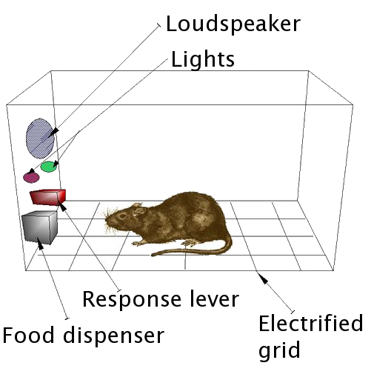
Skinner box

Slide 18
Cognitive Psychology
The idea behind Cognitive Psychology is that determining how we behave is governed by studying thought processes. Such as what was the thought process that caused a specific behaviour or decision? Cognitive Psychology takes into account processes such as memory, thinking, problem solving, language and decision making. As a whole, Cogntive Psychology will take into account a person’s beliefs, desires, ideas, knowledge, and motivations.

Slide 19
Humanistic Psychology
A study of Psychology from the 1950’s that focused on how motivations had an effect on thought and behavior.
Humanists has a holistic approach to human existence through investigations of meaning, values, freedom, tragedy, personal responsibility, human potential, spirituality, and self-actualization (generically described as the motive to realize one full potential). The reason the Humanistic approach to Psychology was developed was because it seemed that other approaches at the time (1950s) focused on disturbed behaviors, whereas the humanistic approach would focus on healthy individuals to try and determine how they define themselves while maximizing their full potentials. The way this was measured was through Abraham Maslow’s Hierarchy of Needs.

Slide 20
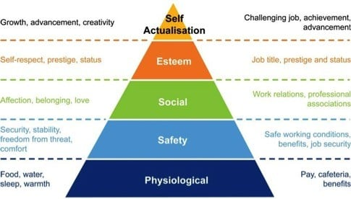
Abraham Maslow’s Hierarchy of Needs.

Slide 21
Cross Cultural Psychology
This is the study of how human behavior can vary in different cultures. This can give psychological researchers a better understanding of behaviors that may be cause by either inherit, environmental or genetic factors. For example: by looking at universal behaviors versus unique behaviors it may be possible to identify how cultures impact behavior, family life, education, social experiences and other psychological areas.

Slide 22
Psychodynamic Psychology
Psychodynamic Psychology focusses on the unconscious mind, early childhood experiences, and interpersonal relationships. This school of Psychology has its roots tied to its founder psychologist Sigmund Freud, and currently is an evolving multi-disciplinary field analyzing and studying human through processes, response patterns, and influences.

Slide 23
Human Relations Theory
In these experiments, it evaluated the attitudes and psychological reactions of workers in on-the-job situations. It began by examining the impact of illumination levels on worker productivity. Eventually, the study was extended through the early 1930s and addressed a broader range of workplace conditions.
The findings were as follows:
Group dynamics (Social Factors) are important determinants of job performance and output.
Groups have their own norms and beliefs, independent of the individual members.
Individuals are not solely motivated by compensation. Perceived meaning and importance of ones work are the primary determinants of output.
Employees prefer a cooperative attitude from superiors, rather than command and control.
Communication between management and employees is essential to understand employee issues.
Workplace culture sets production standards - despite standards set by managers.

Slide 24
Human Relation Theory Focuses on
Focuses on people
The organization environment
Human relations are important in motivating people
Motivation depends on team work
Team must fulfill individual and organizational objectives
Individuals and organization desire efficiency by achieving maximum results with minimum inputs.

Slide 25
Classical management principle
Professor Mary Parker Follet
Workers must participate in the decision-making process through defined communication channels.
Employees prefer to be integrated into the decision-making process rather than subject to the command and control of managers.
Working in groups is generally more productive than working individually.
Authority and order in an organization should be de-personalized. The facts of a situation determine the basis of authority and responsibility.
Managers must integrate employee input in the resolution of conflicts that provide a benefit to all interested parties.
Integration between departments or groups within the organization is preferable.

Slide 26
Techniques from Behavioral Psychology
Systematic desensitization is used for clients who have a specific phobia, which is characterized by marked fear or anxiety about an object or situation, like an animal or airplanes. Therapy involves applying relaxation or coping techniques as people are gradually exposed to the object or situation.
Exposure and response prevention is a strategy that involves exposure to fearful situations, and then not engaging in unhelpful coping strategies. This therapeutic technique is used for obsessive-compulsive disorder (OCD) and other types of anxiety disorders.
Token economy reinforces target behavior by giving children and adults symbols or tokens that can be exchanged for something else. It can be used for people with a wide range of mental health issues, as well as in educational settings.
Modeling involves clients learning behavior by imitation alone. It’s used in developmental psychology and can be incorporated into clinical use.

Slide 27
Life skills are essentially those abilities that help promote mental well-being and competence in young people as they face the realities of life.
It is about how you feel about yourself, your emotional balance, your physical health and your independence.
Life skills are defined as “a group of psychosocial competencies and interpersonal skills that help people make informed decisions, solve problems, think critically and creatively, communicate effectively, build healthy relationships, empathize with others, and cope with and manage their lives in a healthy and productive manner.

Slide 28
Importance of Life Skill
Find new ways of thinking and problem solving.
Recognize the impact of their actions and teaches them to take responsibility for what they do rather than blame others.
Build confidence both in spoken skills and for group collaboration and cooperation.

Slide 29
Self-awareness Skills
Self-awareness — knowing and living with oneself: This theme covers topics that foster the student’s relationship and under- standing of themselves including their thoughts, feelings and behaviors.
1. Stress management
2. Emotional regulation
3. Positive thinking
4. Self-esteem

Slide 30
Interpersonal Skills
Interpersonal Skills — knowing and living with others: The lessons in this theme explore how to establish healthy, respectful relation- ships; lessons highlight the use of non-violent communication, assertiveness and dispute resolution.
5. Empathy
6. Listening skills
7. Interpersonal effectiveness
8. Handling disputes
9. Managing relation- ships
10. Confident communication

Slide 31
Thinking Skills
Thinking Skills — making effective decisions: The skills taught in this theme include concrete ways of thinking and executing tasks so that youth will make effective decisions, set relevant goals, and be informed consumers of information.
11. Goal setting
12. Decision making
13. Problem solving
14. Critical and creative thinking
15. Executive function skills
16. Resilience (bouncing back from adversity)

Slide 32
Self awareness and self discovery
Self-discovery and awareness means understanding one's thoughts, feelings, values and background and how they impact the success of the interaction and relationship, or how they may influence one's work

Slide 33
If you want to be
Happy
Persuasive/ Influential
Good decision Maker
Have Leadership Qualifies.
Then should know your inner strengths.
"Self-awareness is the ability to focus on yourself and how your actions, thoughts, or emotions do or don't align with your internal standards. If you're highly self-aware, you can objectively evaluate yourself, manage your emotions, align your behavior with your values, and understand correctly how others perceive you."

Slide 34
Public self-awareness:
Body language
Communication
Behave and accept social norms
Appearance

Slide 35
Private self-awareness:
For example, you may notice yourself tensing up as you are preparing for an important meeting. Noticing the physical sensations and correctly attributing them to your anxiety about the meeting would be an example of private self-awareness.
When self-awareness tips into self-consciousness, we are reluctant to share certain aspects of ourselves. We develop a persona that lacks authenticity

Slide 36
Benefits of self-awareness
It gives us the power to influence outcomes
It helps us to become better decision-makers It gives us more self-confidence — so, as a result, we communicate with clarity and intention
It allows us to understand things from multiple perspectives
It frees us from our assumptions and biases
It helps us build better relationships
It gives us a greater ability to regulate our emotions
It decreases stress
It makes us happier

Slide 37
Dealing with Self awareness
The danger of the "why" question is that it sends us down the rabbit hole of our negative thoughts.
We focus on our weaknesses and insecurities.
Consider Amy, a new junior executive who has difficulty speaking up at meetings. She may explain her experience to herself by thinking, "I don't speak up at meetings because I fall too low in the corporate food chain. No one's going to listen to me.“
Asking the "what question" puts us into the objective and open space of considering all the factors influencing a particular outcome. For example, instead of “Why don't I speak up at meetings?” we could ask:
"What were the interpersonal dynamics in the room?"
"What was I experiencing in my body at the time?"
"What happened that caused me to go into my old story of not being good enough?”
“What can I do to overcome my fear of speaking up?"

Slide 38
Behavior and Human Behavior
Behavior refers to the actions or reactions of an object or organism, usually in relation to the environment.
Behavior can be conscious or unconscious, overt or covert, and voluntary or involuntary.
Human Behavior: Is the collection of activities performed by human beings and influenced by culture, attitudes, emotions, values, ethics, authority, persuasion.
Human behavior is the potential and expressed capacity (mentally, physically, and socially) of human individuals or groups to respond to internal and external stimuli throughout their life.

Slide 39
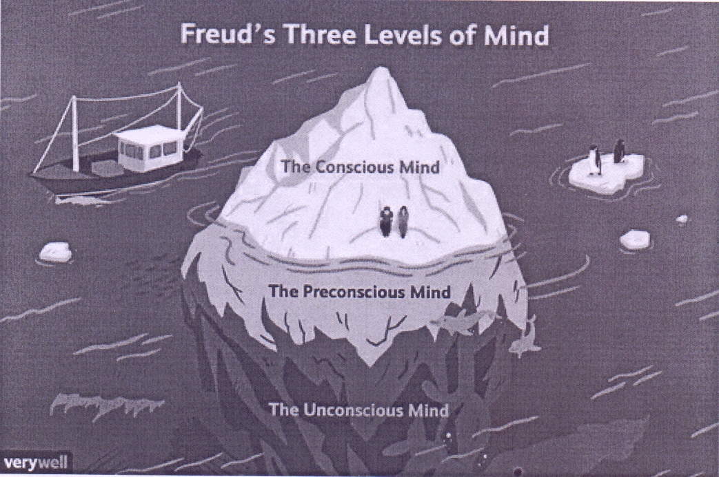


Slide 40
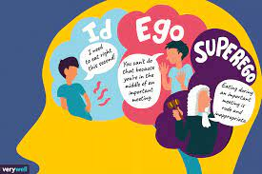

Slide 41
Basic personality types
Optimistic,
pessimistic,
Introvert and Extrovert,
Trusting and envious
Examples of Human Behavior Skills Responses Acceptance Rejection, resistance to change
Ignorance of Life, Dreaming, Sleeping, Communications
Human time-scale - Desire, Hunger, Thirst

Slide 42
Factors affecting Human Behavior
Attitudes: the degree to which the person has favorable or unfavorable evaluation of the behavior in the question.
Social Norms – This is the influence of social pressure that is perceived by the individual (normative beliefs) to perform or not perform a certain behavior.
Perceived Behavioral Control – This is defined as the individual’s belief concerning how easy or difficult performing the behavior will be.

Slide 43
A Shift in Theories
Long before theorists started writing about employee satisfaction and good working conditions, management considered leadership, with its sole interest in high production and efficiency, to be the most important to an organization's success.
Later, it was concern for worker satisfaction and good working conditions that formed the foundation for behavioral management theory.

Slide 44
Behavioral management theory relies on the notion that managers will better understand the human aspect to workers and treat employees as important assets to achieve goals. People are the assets in organization.
Management taking a special interest in workers makes them feel like part of a special group.

Slide 45
Key Developments in OB History
The Hawthorne Studies at Western Electric
  Originally intended as a study of the effects of environmental changes on productivity.
  The Hawthorne Effect— the tendency of people to behave differently (perform better) when they receive attention.
    Key Findings
      Economic incentives are less important than generally believed.
      Dealing with human problems is complicated and challenging.
      Leadership practices and work-group pressures strongly influence productivity, satisfaction, and performance.
      Personal problems influence worker productivity.
      Effective communication is important for success.

Slide 46
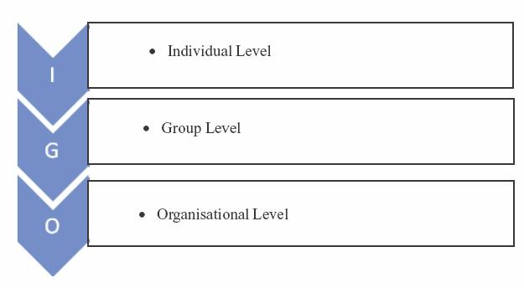
Levels of Analysis

Slide 47
Levels of Analysis
Level 1. Individual: Where the focus is on processes/phenomenon such as attitude, belief, intelligence and motivation that influence how people behave as individuals.
Level 2. Group: This is concerned with social and interpersonal aspects, such as group dynamics and leadership.
Level 3. Organization: It is concerned with the behavior of organization as a whole e.g. culture, structure and processes.

Slide 48
Most organizations employ a total person approach. This approach recognizes that an organization does not just employ someone with skills, but rather, the whole person. This person comes with biases, personal challenges, human relations skills, and technical skills but also comes with experiences. By looking at a person from this perspective, an organization can begin to understand that what happens to an employee outside of work can affect his or her job performance. For example, assume Kathy is doing a great job at work but suddenly starts to arrive late, leave early, and take longer lunches. Upon further examination, we might find that Kathy is having childcare issues because of her divorce. Because of a total person approach perspective, her organization might be able to rearrange her schedule or work with her to find a reasonable solution. This relates to human relations because we are not just people going to work every day; we are people who live our personal lives, and one affects the other. Because of this, our human relations abilities will most certainly be affected if we are experiencing challenges at home or at work.

Slide 49
Henri Fayol began looking at how management could improve productivity instead of focusing on specific tasks and motions. Fayol created the Fourteen Principles of Management, which focused on management but also hinted to the importance of human relations

Slide 50
14 Management principles
Division of work. Work should be divided in the most efficient way. Fayol believed work specialization, or the focus on specific tasks for teams or individuals, to be crucial to success.
Authority. Authority is the right to give orders and accountability within those orders. Fayol believed that along with giving orders and expecting them to be met, that person in authority also assumes responsibility to make sure tasks are met.
Discipline. Discipline is penalties applied to encourage common effort, as a successful organization requires the common effort of all workers.
Unity of command. Workers should receive orders from only one manager. In other words, reporting to two or more managers would violate Fayol’s Fourteen Principles of Management.
Unity of direction. Everyone in the organization should move toward a common goal and understand how the team will achieve that goal.
Subordination of individual interests to general interests. The interests of one person shouldn’t have priority over the interests of the organization as a whole. This focuses on teamwork and the importance of everyone acting toward the same goal.
Remuneration. Many things should be considered when paying employees, including cost of living, supply of qualified people, and business success.
Centralization. The degree of importance in the subordinates’ (employees’) role in their organization and the amount of decision making that occurs at a central level versus a decentralized level. For example, in many organizations decisions are made centrally (i.e., in the “corporate office”), which does not allow as much flexibility as decentralized decision making; this would mean each individual area can make its own decisions.
Scalar chain. This refers to how authority is divided among managers. Specifically, Fayol said lower-level managers should always keep upper-level managers informed.
Order. All materials and people related to one kind of work should be organized and neat. Things should be easy to find.
Equity. All employees should be treated equally.
Stability of tenure of personnel. Retention of employees should be a high management priority. The cost of hiring a new worker is expensive, so efforts should be maintained to keep current employees.
Initiative. Management should take steps to encourage workers to take initiative. In addition, workers should be self-directed and not need a lot of management control to accomplish tasks.
Esprit de corps. Managers should encourage harmony among employees. This harmony creates good feelings among employees

Slide 51
What is Management?
“The art of getting things done through people”

Slide 52
Who is a Manager?
Someone whose primary responsibility is to carry out the management process
Someone who plans and makes decisions, organizes, leads, and controls human, financial, physical, and information resources.

Slide 53
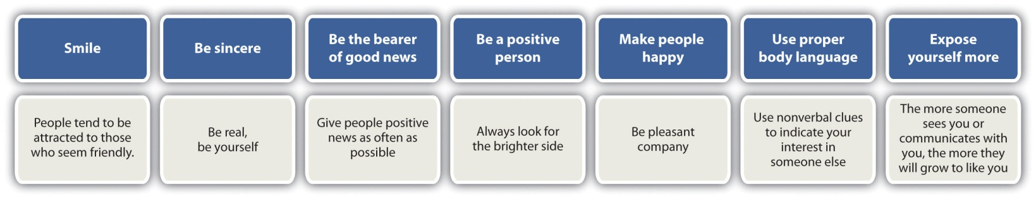

Slide 54
Scope
Intrapersonal behavior covers aspects as
Personality
Attitude
Perception
learning
Opinion
Motivation
Job satisfaction

Slide 55
Scope
Intrapersonal behavior includes
group dynamics
inter group conflict
leadership
communication
transactional analysis

Slide 56
About organisation
About organisation the study covers aspects like
formation
structures
effectiveness
formal and informal organisation

Slide 57
People Management
Working with people from different cultures: As a manager one must learn how to adapt his managerial style to their cultural, geographic and religious disparities.
Workforce diversity: Organizations are increasingly becoming a mix of people in terms of gender, race, age, ethnicity and. So mangers must recognize the fact that they don’t leave their lifestyles, cultural values and perception at home, so managers must learn to accommodate this diverse group of people by addressing their different lifestyles, family needs and work styles.

Slide 58
Customer Service: Many an organization has failed because its employees failed to please its customers. Management needs to create a customer-responsive culture. OB can provide considerable guidance in helping managers create such cultures- cultures in which employees are friendlier and courteous, accessible, knowledgeable and prompt in responding to customer needs.
Ethics: Today’s manager needs to create an ethically healthy climate for his employees, where they can work productively and confront a minimal level of uncertainty regarding what constitutes right and wrong behavior.

Slide 59
Key Managerial Roles
(Henry Mintzberg)
Informational
Interpersonal
Decisional
Monitor
Disseminator
Spokesperson
Positions the manager so as to facilitate the sending and receiving of information
Figurehead
Leader
Liaison
Involves the manager in relationships with other individuals both inside and outside the firm
Entrepreneur
Disturbance handler
Resource allocator
Negotiator
The manager uses the available information
to make important decisions

Slide 60
Roles of managers
Informational Roles:
  collecting information about various organisations and institutions regarding technological development, employment, taste, preferences of public.
  monitor role:.e.g from news paper, journals, magazine etc.
  disseminator: transmitting information to other members in the organisation.
  spokesperson: representing organisation to outside parties.e.g press, clients and business partners.

Slide 61
Roles of managers
Interpersonal Roles:
  Figure head roles: attend certain ceremonial duties. e.g visiting different branches.
  Leadership roles: includes hiring, training, motivating.
  Liaison roles: interacting with individual, group inside and outside organisation.

Slide 62
Roles of managers
Decision Roles
  entrepreneur role: e.g. initiating new projects and monitoring their progress.
  disturbance handlers
  resource allocator
  negotiators

Slide 63
Management Levels Defined
First line Managers
  directly responsible for day-to-day operations
  supervise and coordinate the activities of operating employees
Middle Managers
  work in the middle levels of the organization
  responsible for sections or departments
  supervise and coordinate the activities of
  lower-level managers
  responsible for implementing the policies and plans of top managers

Slide 64
Management Levels Defined
Top (or Senior) Managers
  usually form a team
  manage the organization’s overall goals, strategy, and operating policies
  responsible for the entire enterprise
Middle and top managers may also be:
  Functional Managers
    responsible for a distinct function in the enterprise

Slide 65
Horizontal Differences
Functional managers
  Responsible for departments that perform a single functional task
General managers
  Responsible for several departments that perform different functions

Slide 66
Managers by Area
Marketing Managers
  Work in areas related to getting consumers and clients to buy the organization’s products or services
Financial Managers
  Deal primarily with an organization’s financial resources
Operations Managers
  Concerned with creating and managing the systems that create organization’s products and services

Slide 67
Manager by Area
Human Resource Managers
  Human resource planning, recruiting and selection, training and development, designing compensation and benefit systems, formulating performance appraisal systems
Administrative Managers
  Familiar with all functional areas of management.
Other Kinds of Managers
  Specialized managerial positions directly related to the needs of the organization
  May include IT management

Slide 68

Management Skills
Top Managers
Middle Managers
First-Line Managers
Non-managers (Personnel)
Conceptual Skills
“People” Skills Technical Skills
Technical skills: e.g. accoutancy,personal management, engineers, surgeons
Human/peoples skill:e.g art of motivating, interpersonal skills
Conceptual skills: e.g. analyze complex situation, pinpoint the problems, evaluate them

Slide 69
Fundamental Management Skills
Technical
  Skills necessary to accomplish or understand the specific kind of work being done in an organization
Interpersonal
  Ability to communicate with, understand, and motivate both individuals and groups
Conceptual
  Ability to think in the abstract and to see the organization as a complete unit and to integrate and give direction to its diverse activities so that objectives are achieved

Slide 70
Fundamental Management Skills
Diagnostic
  Ability to visualize the most appropriate response to a situation
Communication
  Abilities both to convey ideas and information effectively to others and to receive ideas and information effectively from others
Decision-Making
  Ability to recognize and define problems and opportunities correctly and then to select an appropriate course of action to solve the problems and capitalize on opportunities

Slide 71
Fundamental Management Skills
Time-Management
  Ability to prioritize work, to work efficiently, and to delegate appropriately

Slide 72
The Organization as an Iceberg Metaphor

Slide 73

SELF ESTEEM AND SELF CONFIDENCE

Slide 74
"Confidence" comes from the Latin fidere, "to trust." To be self-confident is to trust in oneself, and, in particular, in one’s ability or aptitude to engage successfully or at least adequately with the world.
A self-confident person is ready to rise to new challenges, seize opportunities, deal with difficult situations, and take responsibility if and when things go wrong.

Slide 75
"Esteem" is derived from the Latin aestimare, meaning "to appraise, value, rate, weigh, estimate," and self-esteem is our cognitive and, above all, emotional appraisal of our own worth.
Self-esteem is simply how you feel about yourself and how you judge your worth.

Slide 76
Self-confidence and self-esteem do not always go hand in hand. In particular, it is possible to be highly self-confident and yet to have profoundly low self-esteem, for example, with many performers and celebrities, who can perform before an audience of thousands but then damage and even kill themselves with drugs.

Slide 77


Slide 78
What causes low self-esteem?
systematic punishment, neglect or abuse
failing to meet parental standards
failing to meet peer-group standards
being on the receiving end of other people's stress or distress.
belonging to a family or social group that other people are prejudiced towards
an absence of praise, warmth, affection or interest
being the odd one out, at home or at school.

Slide 79
10 steps for improving your self-esteem
Positive self-talk.
Don't compare yourself to others.
Movement and exercise.
Don't strive for perfection.
Don't beat yourself up when you make a mistake.
Focus on the things you can change.
Do things you enjoy.
Celebrate the small stuff.

Slide 80
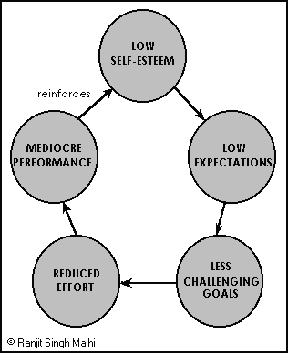

Slide 81
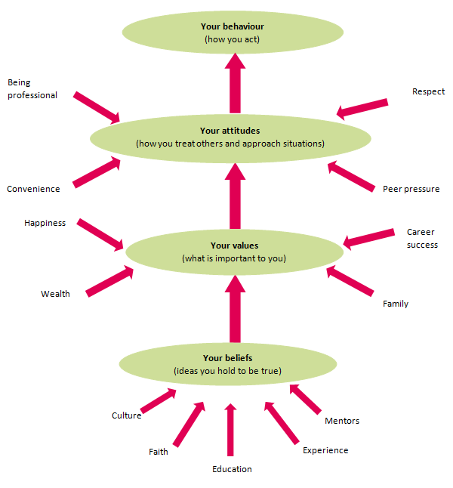

Slide 82
What is a belief?
A belief is an idea that a person holds as being true.
A person can base a belief upon certainties (e.g. mathematical principles), probabilities or matters of faith.
A belief can come from different sources, including:
a person’s own experiences or experiments
the acceptance of cultural and societal norms (e.g. religion)
what other people say (e.g. Education or mentoring).
A potential belief sits with the person until they accept it as truth, and adopt it as part of their individual belief system.
Each person evaluates and seeks sound reasons or evidence for these potential beliefs in their own way.
Once a person accepts a belief as a truth they are willing to defend, it can be said to form part of their belief system.

Slide 83
What is a personal value?
Values are stable long-lasting beliefs about what is important to a person. They become standards by which people order their lives and make their choices.
A belief will develop into a value when the person’s commitment to it grows and they see it as being important.
It is possible to categorize beliefs into different types of values – examples include values that relate to happiness, wealth, career success or family.
A person must be able to articulate their values in order to make clear, rational, responsible and consistent decisions.

Slide 84
What is an attitude?
Attitudes are the mental dispositions people have towards others and the current circumstances before making decisions that result in behavior. People primarily form their attitudes from underlying values and beliefs.
However, factors which may not have been internalized as beliefs and values can still influence a person’s attitudes at the point of decision-making. Typical influences include the desire to please, political correctness, convenience, peer pressure, and psychological stressors.
A lack of self-awareness or critical insight, or the presence of ambivalence or uncertainty about values, can lead to a less rational attitude to choices, and ultimately to undesirable behavior.

Slide 85
Components of Attitude
Cognitive Component: Your thoughts and beliefs about the subject
Affective Component: How the object, person, issue, or event makes you feel
Behavioral Component: How attitude influences your behavior
Affective component: involves a person’s feelings / emotions about the attitude object. For example: “I am scared of spiders”.
Behavioral (or conative) component: the way the attitude we have influences on how we act or behave. For example: “I will avoid spiders and scream if I see one”.
Cognitive component: involves a person’s belief / knowledge about an attitude object. For example: “I believe spiders are dangerous”.
Attitudes can also be explicit and implicit.
Explicit attitudes are those that we are consciously aware of and that clearly influence our behaviors and beliefs.
Implicit attitudes are unconscious but still have an effect on our beliefs and behaviors.

Slide 86
What Is Self-Awareness?
Levels of Self-Awareness
So how exactly do children become aware of themselves as separate beings? Researchers suggest that children progress through a series of levels of self-awareness between birth and approximately age 4 or 5. Self-awareness is observed by how children respond to their own reflection in a mirror.
Level 1: Differentiation - At this point, children start to become aware that what it reflected in a mirror is different from what they simply perceive in the environment.
Level 2: Situation - This level of self-awareness is characterized by a growing understanding that self-produced movements can be seen in the mirror's surface. Children are also aware that it is their own movements they are observing.
Level 3: Identification - At this point, children recognize the image in the mirror as themselves rather than someone else staring back at them.
Level 4: Permanence - Children can not only identify themselves reflected in a mirror, they can also identify their own image in pictures and home movies.
Level 5: Self-consciousness or "meta" self-awareness - At this level, children are not only aware of themselves from their own perspective, but also become aware of how they are in the minds of others.

Slide 87
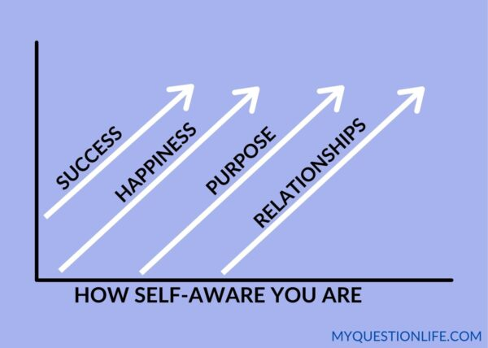

Slide 88
Self Awareness
Self Acceptance
Readiness to change
Change/Transformation
Termination

Slide 89


